Slide 1
Apollo Trading Platform
ICG Technology | Analyst Program
Final Project Demo | August 2018
Ketan Reddy, Robert Trujillo, Zoe Grippo
Strictly Private and Confidential

Slide 2
Table of Contents
1. | Introduction
2. | System Architecture
 | A. Overall
 | B. Runner
 | C. Web User Interface D. Database
3. 4. | Further Improvements Demonstration and Code

Slide 3
1. Introduction
Motivations and Strategy

Slide 4
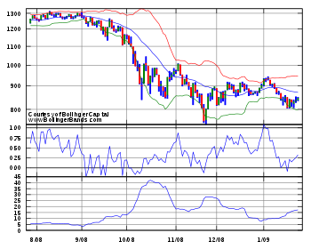
Introduction
Goals
Monitor live market data
Create automated trading strategies, edit, update, delete these strategies
Monitor trades performed, analyze performance, profits
Trades based on Bollinger Bands Strategy
“This strategy seeks to take advantage of volatility in a stock, expecting it to return to its established pattern. Take a moving average over some period and calculate the standard deviation for that period. If the price then hits some multiple of the standard deviation go long or short it. Exit at a position at a percentage-based profit or loss threshold.”

Slide 5
2. System Architecture

Slide 6
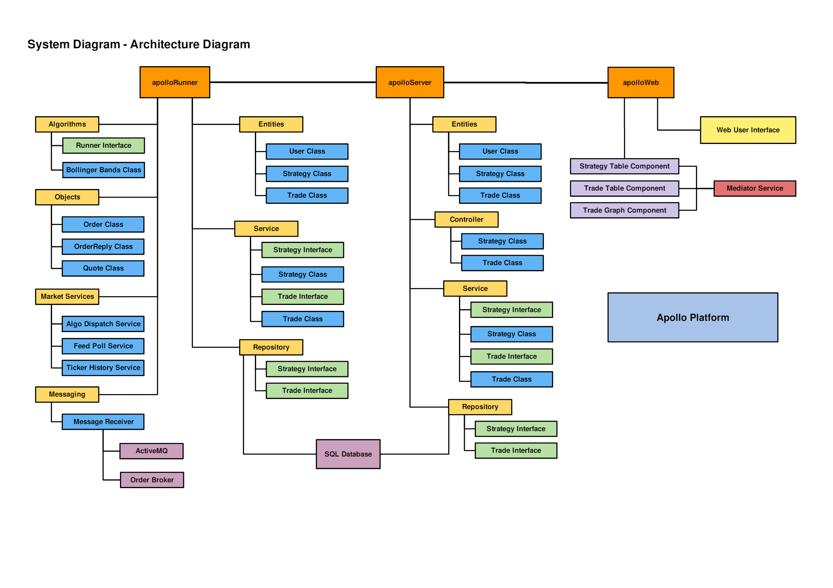
Overall

Slide 7
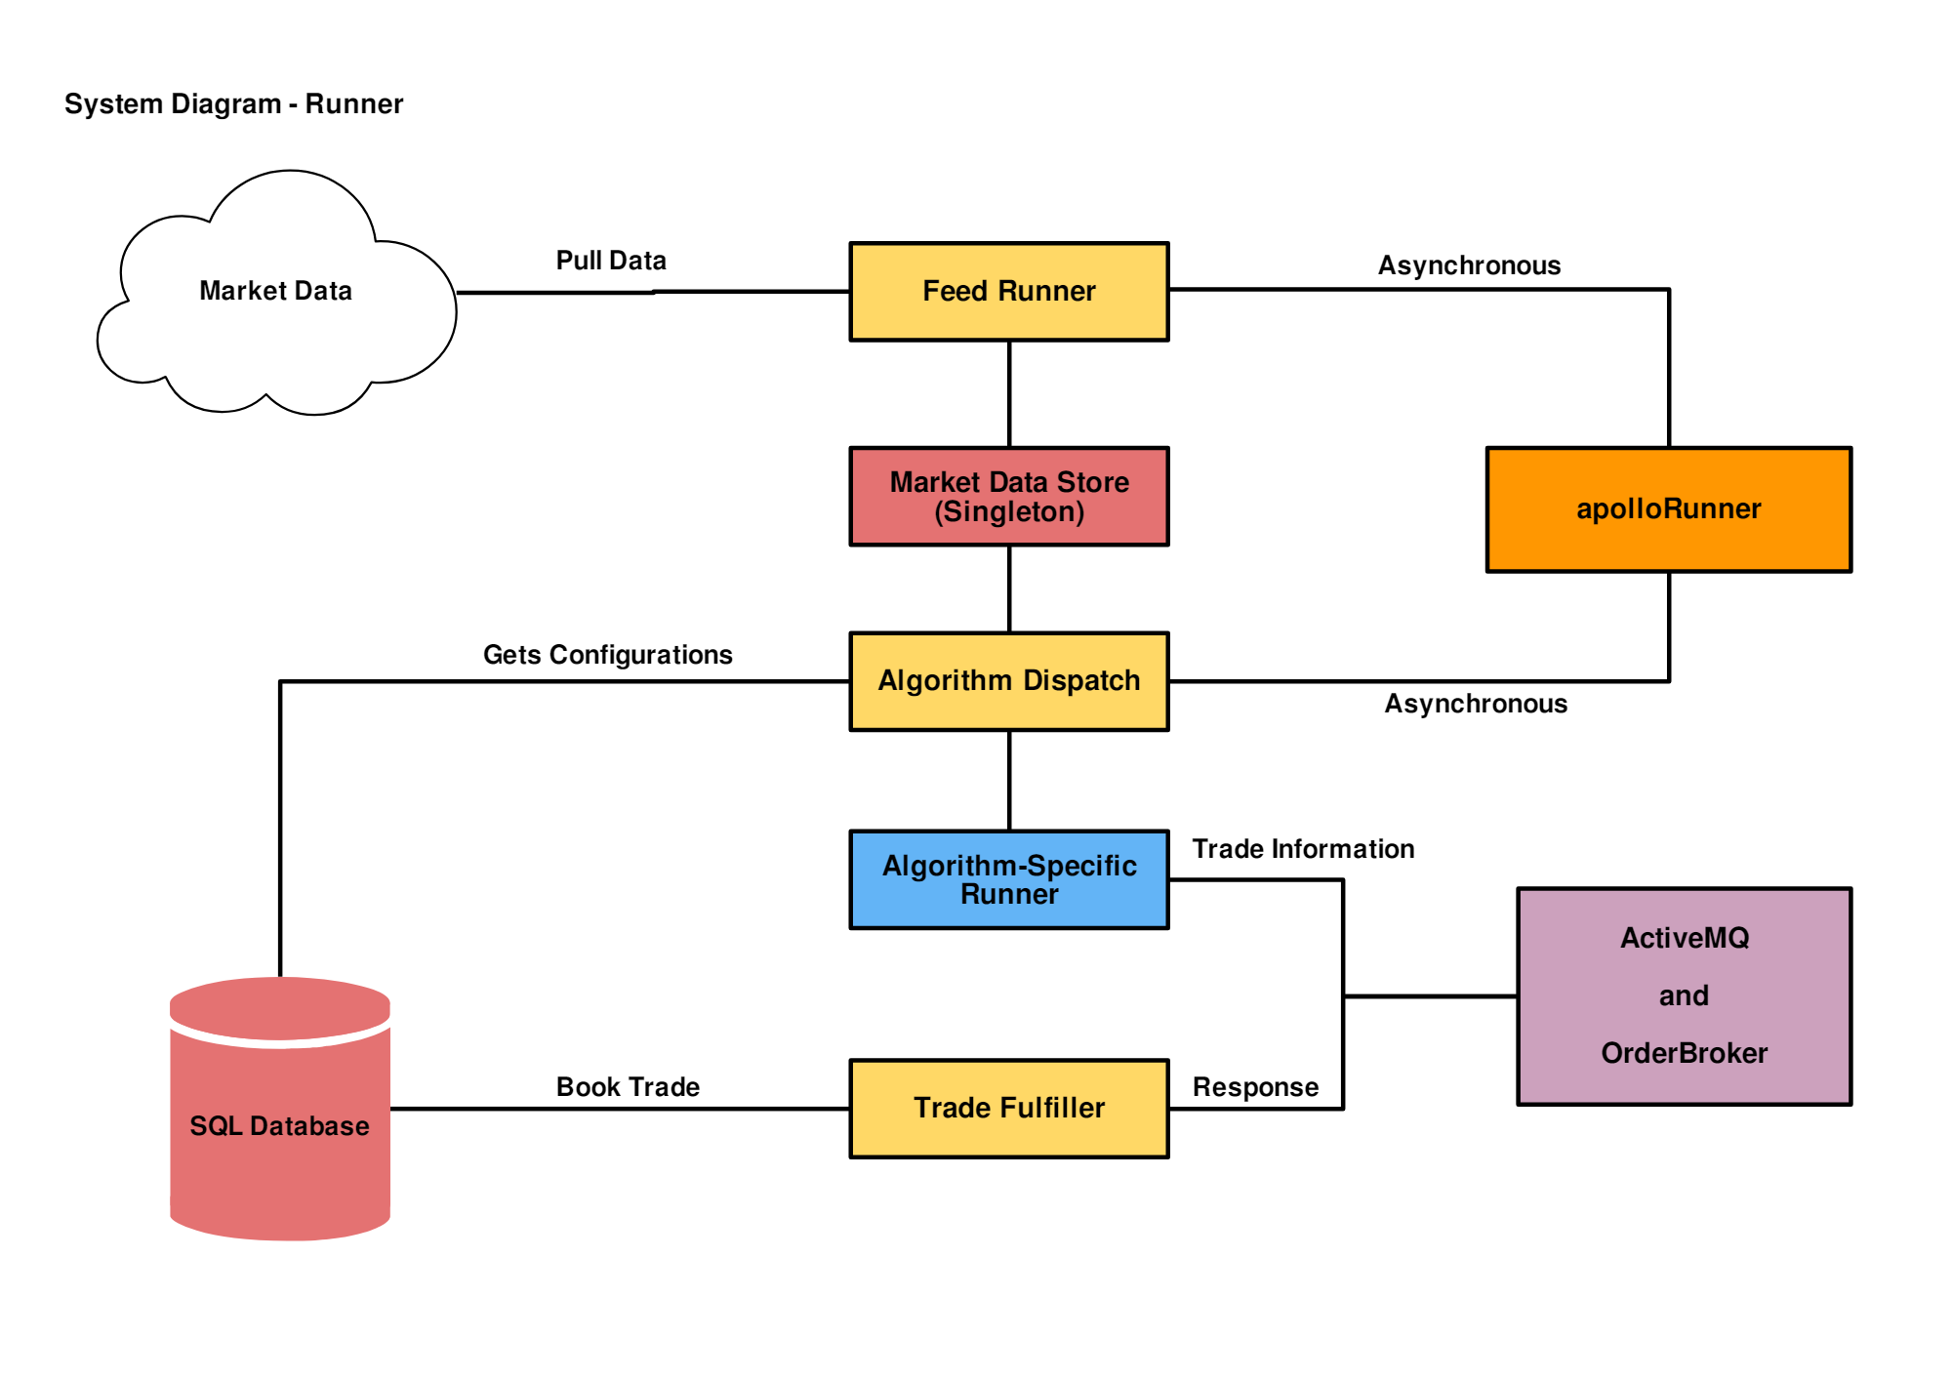
Runner

Slide 8
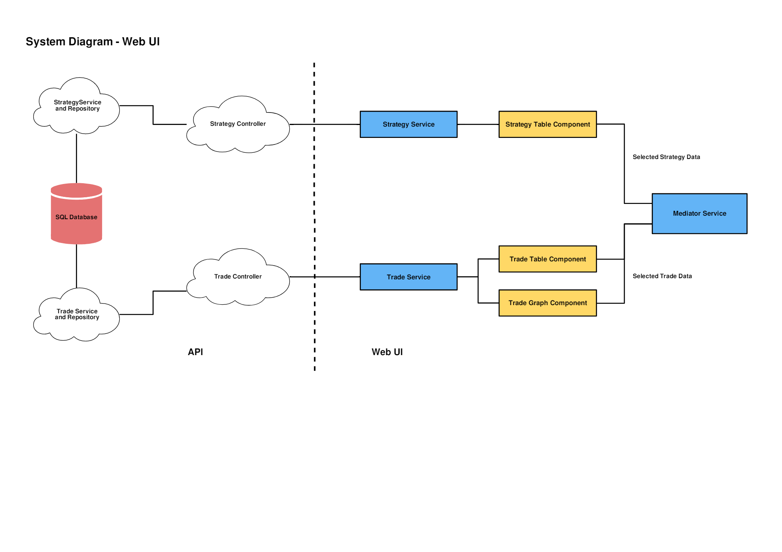
Web User Interface

Slide 9
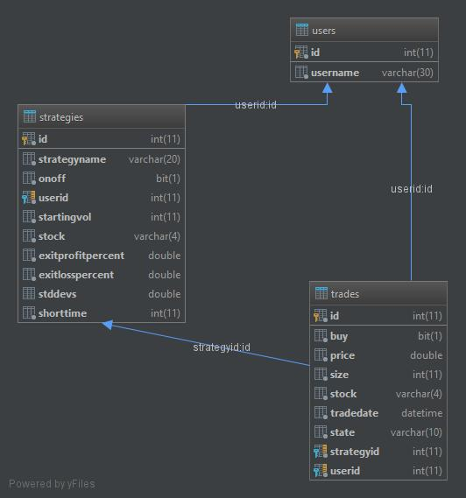
Database

Slide 10
3. Further Improvements

Slide 11
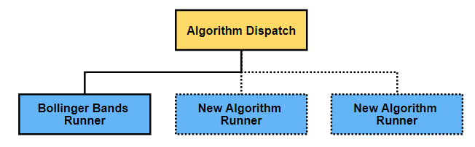
Further Improvements
Implement more strategies
Two Moving Averages and Price Breakout
Add users
This feature will be possible to implement with current database design
Make a separate component for Algorithm Dispatch for scalability
Create different Runners for each Strategy from here

Slide 12
4. Demonstration
Live Demonstration, Code, Unit Tests

Slide 13
Questions?

